Slide 1
Introduction to Research
Class 2 Psyc 3510

Slide 2
Constructs and Operational Definitions
Constructs are hypothetical attributes or mechanisms that help explain and predict behavior in a theory.

Slide 3
Constructs and Operational Definitions
An operational definition is a procedure for measuring and defining a construct.

Slide 4
Constructs and Operational Definitions
Problems with operational definitions
Components left out
Extra components included

Slide 5
Constructs and Operational Definitions
Operationalize:
Rain
Adolescence
Depression

Slide 6
Constructs and Operational Definitions
Group Activity
In groups of three, write an operational definition for the given construct
Have a nearby group try to guess your construct using ONLY your operational definition.

Slide 7
Validity
Validity: Measurement procedure is actually measuring what you claim it is measuring.

Slide 8
Validity
Face Validity: Look like it measures what it measures?

Slide 9
Validity
1.
0) I do not feel sad.
1) I feel sad
2) I am sad all the time and I can't snap out of it.
3) I am so sad and unhappy that I can't stand it.
2.
0) I am not particularly discouraged about the future.
1) I feel discouraged about the future.
2) I feel I have nothing to look forward to.
3) I feel the future is hopeless and that things cannot improve.
3.
0) I do not feel like a failure.
1) I feel I have failed more than the average person.
2) As I look back on my life, all I can see is a lot of failures.
3) I feel I am a complete failure as a person.

Slide 10
Validity
Concurrent Validity: scores obtained from measure are directly related to scores from an established variable

Slide 11
Validity
Consistency of Relationship: Demonstrated through correlations
Positive relationship
Negative relationship

Slide 12
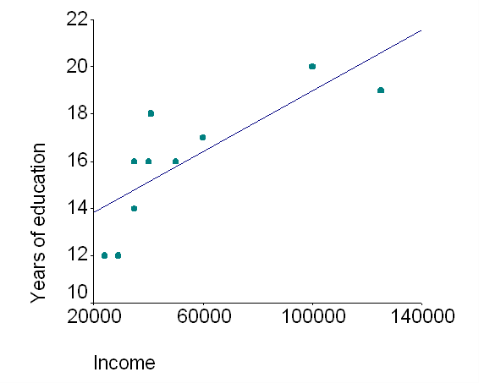
Validity
Positive Relationship:

Slide 13
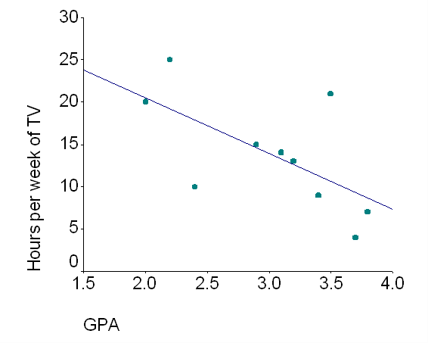
Validity
Negative Relationship:

Slide 14
Validity
Predicative Validity: Scores from measure accurately predict theorized behavior

Slide 15
Validity
Construct Validity: measurement procedure scores behave as behavior is theorized to behave.

Slide 16
Validity
Convergent Validity:
Create two different methods
Show methods are positively related (converge)

Slide 17
Validity
Divergent Validity:
Create convergent score for second construct
Demonstrate no relationship between target construct and second construct.

Slide 18
Reliability
Reliability: measurement produces identical results when measuring the same individual under the same conditions.

Slide 19
Reliability
Measurement score = Actual score + Error

Slide 20
Reliability
Test-retest reliability: measurement produces same score on subsequent tests

Slide 21
Reliability
Parallel-forms reliability: Different versions of same measurement produce same scores

Slide 22
Reliability
Inter-rater reliability: Different raters of data produce same scores

Slide 23
Reliability
Split-half reliability: Tests from one half of measurement produce similar scores to tests from second half of test.

Slide 24
Reliability and Validity
Measures must be reliable to be valid, but not valid to be reliable.

Slide 25
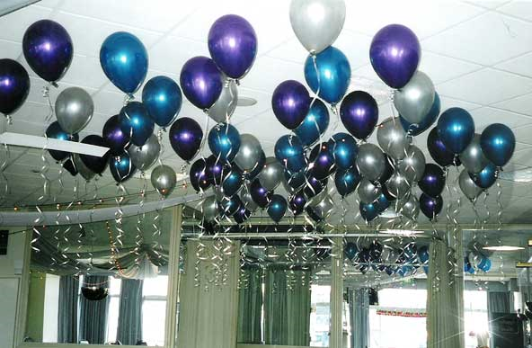
Measurement Effects
Ceiling Effect: All scores are clustered at top of scale, with no possible increases in value.

Slide 26

Measurement Effects
Floor Effect: All scores are clustered at bottom of scale, with no possible decreases in value.

Slide 27
Ethics of Researching

Slide 28
Ethics in Researching
Research ethics: responsibilities of researchers

Slide 29
Ethics in Research
Responsibility 1: ensure the welfare and dignity of the individuals

Slide 30
Ethics in Research
Responsibility 2: Public reports are accurate and honest

Slide 31
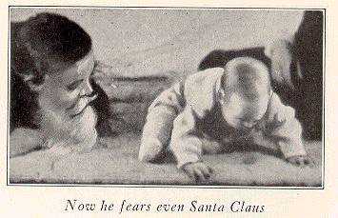
Ethics in Research
History

Slide 32
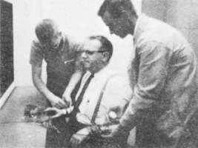
Ethics in research

Slide 33
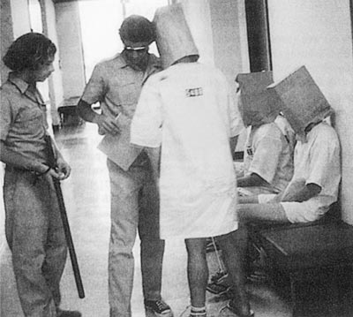
Ethics in Research

Slide 34
Ethics in Research
Principle of no harm: reasonable steps to avoid foreseeable, avoidable physical or psychological harm to individuals.

Slide 35
Ethics in Research
Clinical equipoise: give the best treatment.

Slide 36
Ethics in Research
Principle of Informed Consent: participants should be given complete information about the study and their rights
Right to decline
Right to withdraw
Right to confidentiality
Right to anonymity

Slide 37
Ethics in Research
Problems with informed consent:
Information: How to present and how much to give?

Slide 38
Ethics in Research
Understanding: Do the participants understand informed consent?

Slide 39
Ethics in Research
Voluntary participation: Is it genuine?

Slide 40
Ethics in Research
Study

Slide 41

Ethics in research
Use of Deception
Passive Deception: omitting pertinent information

Slide 42
Ethics in Research
Active Deception: purposefully presenting false information.

Slide 43
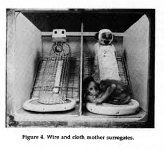
Ethics in Research
Ethics with nonhuman subjects
Qualified Individuals
Minimize Discomfort/Harm
Research must be justified

Slide 44
